Slide 1
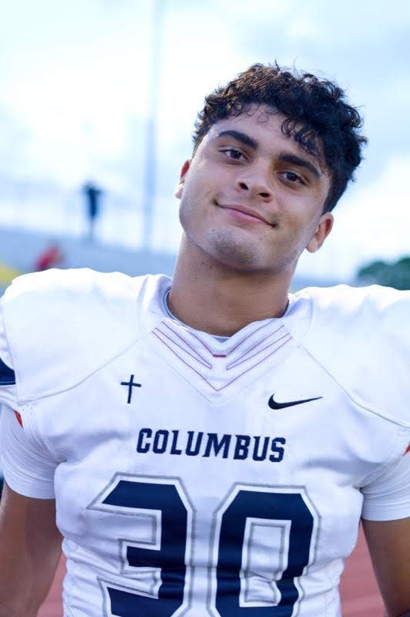


Representative Presentation
“In the same way, let your light shine before others, that they may see your good deeds and glorify your Father in Heaven.”
- Matthew 5:16

Slide 2
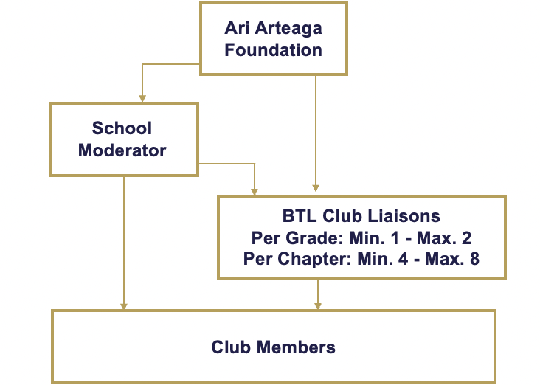
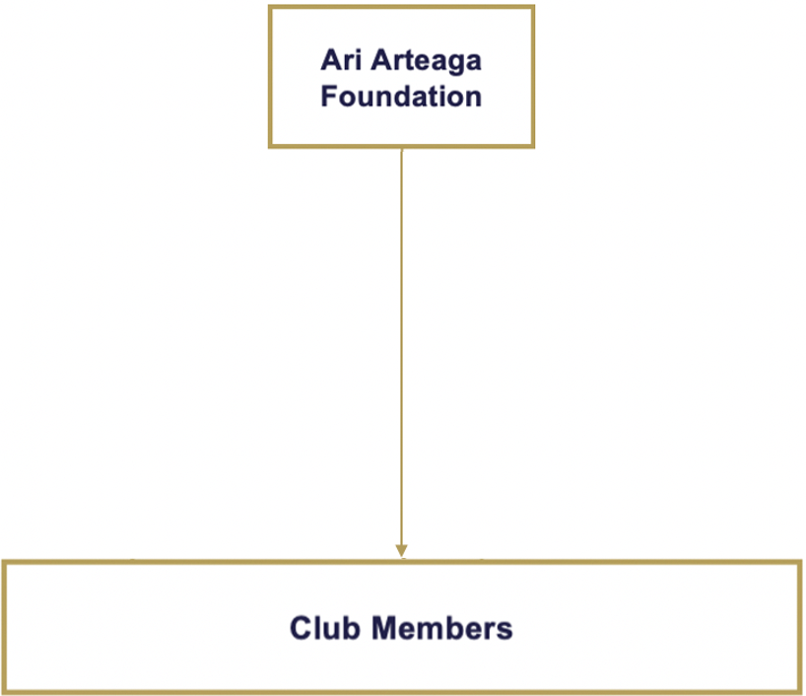


BE THE LIGHT CLUB
COMMUNICATION FLOW CHART
Schools with Established BTL Club Chapters:
Schools with Non-Established BTL Club Chapters:

Slide 3
BTL CLUB REPRESENTATIVE GUIDELINES
The Chapter can have 4 representatives (one per grade) and up to 8 representatives (2 per grade).
Each representative needs to volunteer a minimum of 25 services hours with the BTL CLUB.
The Foundation may appoint representatives, unless the school requires representatives are to be appointed by their administration.
The Foundation may appoint representatives if the BTL CLUB is less than four years old at the school.
All communication between Foundation and representatives regarding their Chapter and the CLUB must be shared with the Moderator, club members and Foundation in a timely manner (within a 24-hour period).
Representatives must schedule four BTL CLUB meetings:
      - September
    - November
    - January
    - March
Representatives cannot miss more than one club meeting in a school year.
Club meeting are to be scheduled during a time of day when all/most club members can attend – right before school/right after school.
Club meetings should not exceed 20 minutes.
Club meeting must include:
  - Meeting Agenda – template provided by Foundation
  - Upcoming volunteer/service opportunities in detail
  - Where to sign up for volunteer opportunity
  - Upcoming fundraiser/s hosted by your chapter

Slide 4
BTL CLUB REPRESENTATIVE GUIDELINES CONT.
In support of our mission, we encourage every chapter to host at least one fundraiser in the school year benefiting the Ari Arteaga Foundation.
  - Fundraiser funds received/collected must be delivered to the Ari Arteaga Foundation with a seven-day period.
Representatives must work together to maintain their BTL CLUB chapter an inclusive club:
  - Be responsible to your role
  - Be respectful to the Moderator and other club members
  - Be inclusive
  - Be responsive to emails, texts, phone calls regarding your participation
  - Have a good and open line of communication. Be approachable and reachable.
  - Share with other non-members about what the club does and encourage them to participate and join.
The Foundation will share their chapter’s club member list with the Moderator and representatives.
Each representative should communicate via text and email with other club members of all upcoming Club events and service opportunities.
INDIRECT SERVICE (FUNDRAISING/DRIVES)
If your club chooses to host and event and/or fundraiser, we will add them to @bethelightclubmiami, @bethelight30_6 and @bethelittlelightclub to support you and help spread community awareness.
Please email SERVICE@ARIARTEAGAFOUNDATION.ORG with your events/fundraisers, or with any questions or suggestions on how to create an event.
Your chapter’s fundraisers and drives must be approved by your school and hosted before, during or after school. Speak to your moderator for assistance and guidance.

Slide 5
CLUB CHAPTERS FUNDRAISER IDEAS
COLLECTION DRIVE IDEAS
*Candle prices shall not vary.
Selling BE THE LIGHT CANDLE Sale (AAF will provide candle sale form with list of candle scents to collect orders). $25 per Candle
Selling I am Blessed/BE THE LIGHT BRACELET Sale
BE THE LIGHT/Ari’s Heart Pop Socket Sale
Hosting a Car wash – combine efforts with another chapter to reach a larger group of supporters. - $5 donation minimum to get car washed.
Bake sale – Bake your own or buy
Dodgeball Tournament at your school
Spike Ball Tournament at your school
Dress down day at school (students pay to dress out of uniform) with BE THE LIGHT GEAR.
Crazy Sock Day or PJ Day
Krispy Kreme Doughnuts Fundraiser
Movie night on your school grounds (in the auditorium, school lawn, or gym)
Karaoke contest during lunch
Family Feud/Jeopardy/Trivia tournament – Pop Culture
Host a dance marathon or themed dance at school
“Drive-In” or movie night on your school yard - movie event
Talent show
Non-perishable Food/water
Toiletry – Travel Size
Diapers/baby supplies
Turkey drive and non-perishables (with Ari Arteaga Foundation)
Christmas toy drive/gift card
Children’s books – new or lightly used
School supplies
Sports Gear

Slide 6
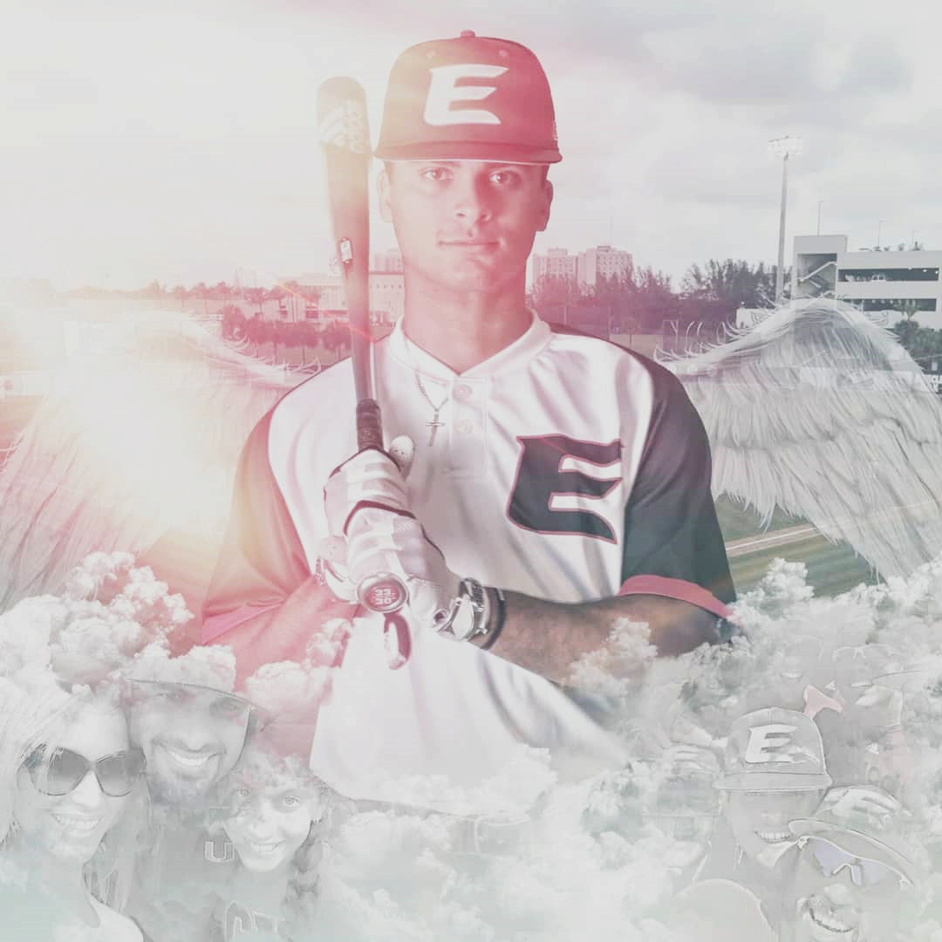
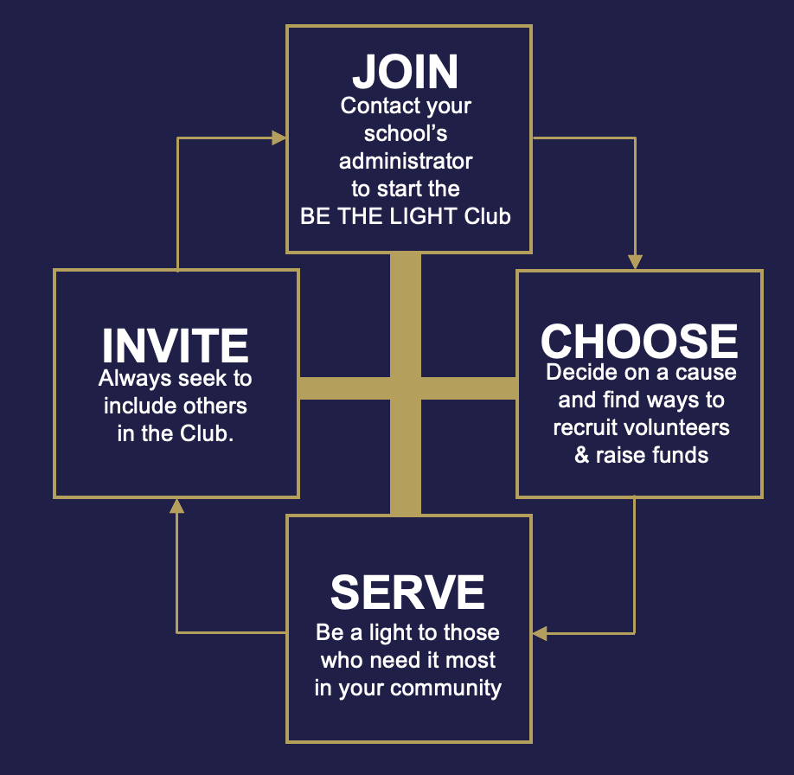
THE
ARI ARTEAGA FOUNDATION
Serves as a constant testimony that although life on this earth is temporary, the impact and expanse of our love is eternal.
Join us in continuing Ari’s legacy by being a light for others through service.
For more information:
www.ariarteagafoundation.org
Email: service@ariarteagafoundation.org

Slide 7
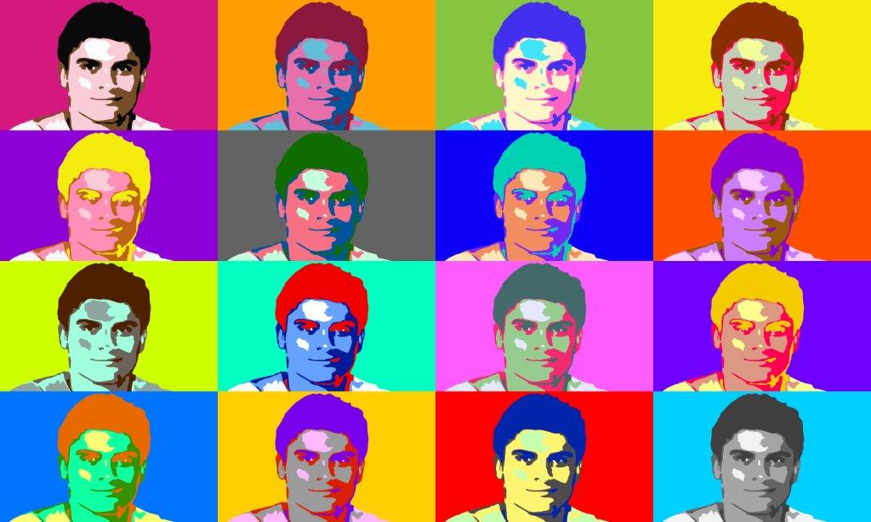

THANK YOU!
KEEP UP WITH US ON SOCIAL MEDIA:
@bethelightclubmiami
@bethelight30_6
@bethelightshop_online

