Slide 1
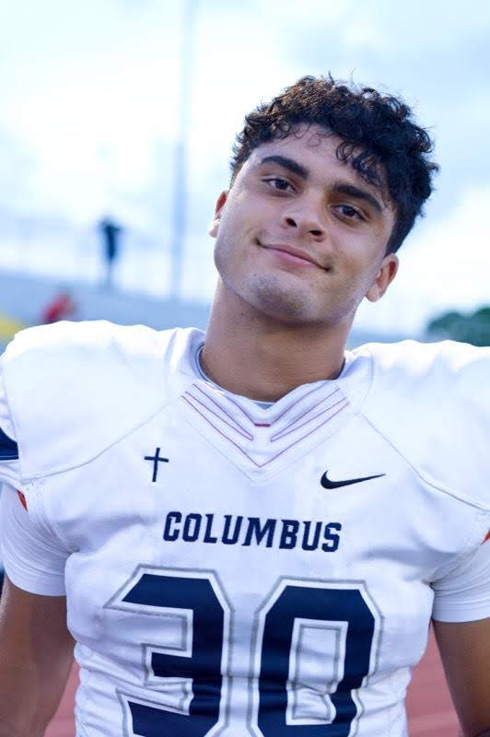


“In the same way, let your light shine before others, that they may see your good deeds and glorify your Father in Heaven.”
- Matthew 5:16

Slide 2




MISSION
Provide scholarships for students, who exemplify Ari’s unique light and characteristics, and who demonstrate financial need after exhausting all other funding resources, so that they may attend private high schools with an emphasis on a Christian education;
Provide financial support beyond high-school and into higher education; and
Provide assistance to these students (and their families) should they experience an unforeseen event or hardship.

Slide 3
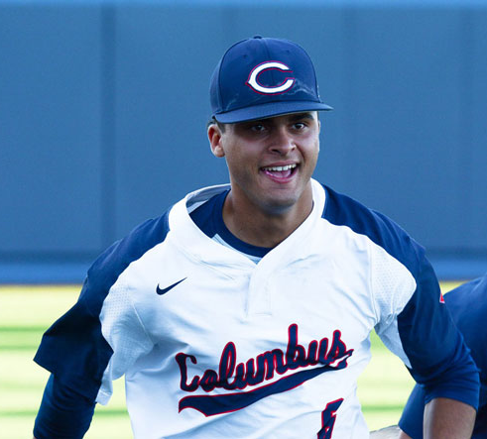
MEET ARI
WHO ARI WAS
A loving son, older brother, and friend to many.
Part of Christopher Columbus High School’s class of 2020.
Played both football and baseball at Columbus.
HOW ARI LIVED
A heart for service.
Touched lives with his extraordinary spirit and natural ability to make others feel cared for.
Lived everyday with joyful energy.
Empowered and brought out the best in everyone.
Never put himself above anyone.
He lived his 16 years of life with a zest for making everyday count for himself and for others.

Slide 4
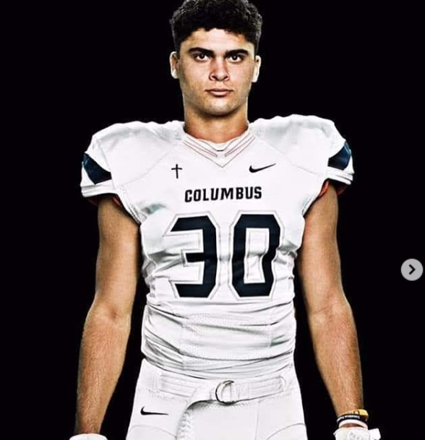
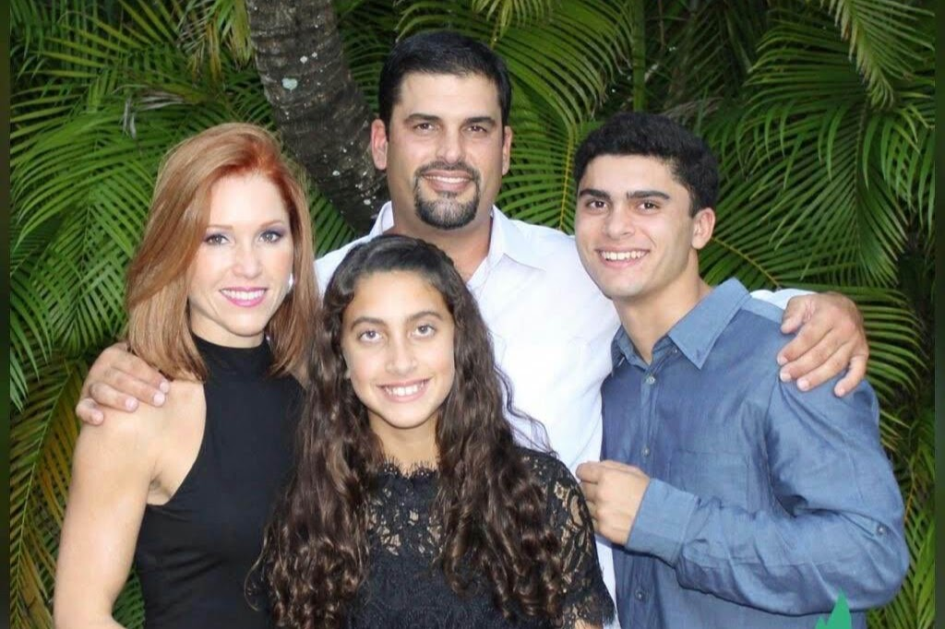
ARI’S SPIRIT
Ari had a special gift of living in the present, not being held back by the past nor worrying about the future. He made every moment count.
In today's world of distractions, Ari was able to give his full attention to the person with whom he was speaking, listening intently and
making the person feel heard and understood.
ARI’S FAMILY
At home, his family taught him the golden rule - be a good person. With this in mind, Ari focused on living with a compassionate heart. He was confident, fun-loving, colorful, and never took himself too seriously. He always made others feel cared for.
Ari's persona was in many ways larger than life itself!

Slide 5
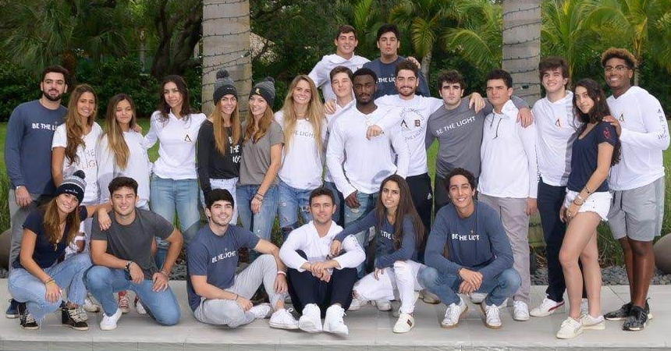
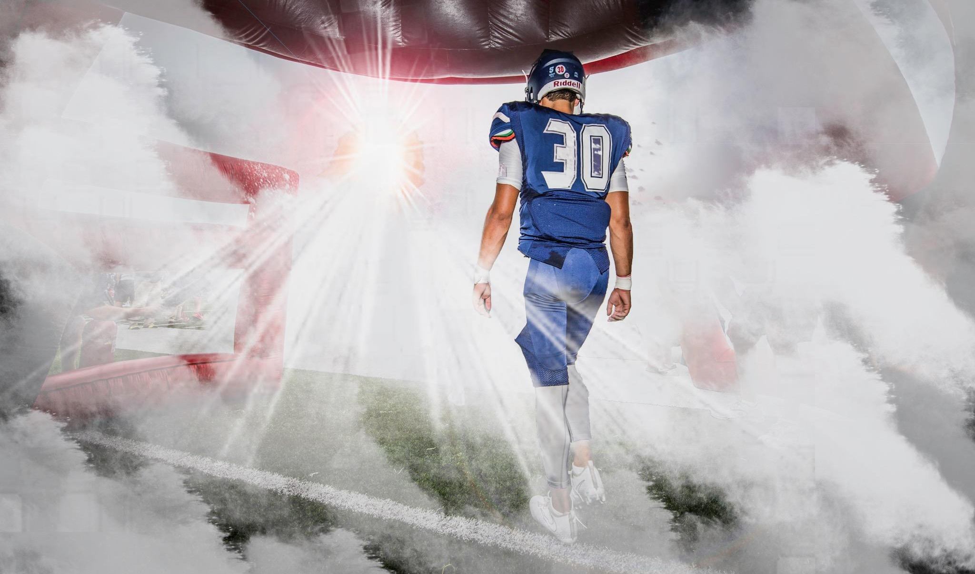
ARI’S FRIENDS
He had a special group of friends but was always inclusive of others.
He appreciated each person for their character, not for what they looked like or where they came from.
He expanded his circle of friends every day of his life.
IN HIS MEMORY
Ari suffered a tragic auto accident at the age of 16, but his memory and spirit lives on.
BE THE LIGHT
has become a way for others to spread Ari’s joy and for life through service. enthusiasm

Slide 6
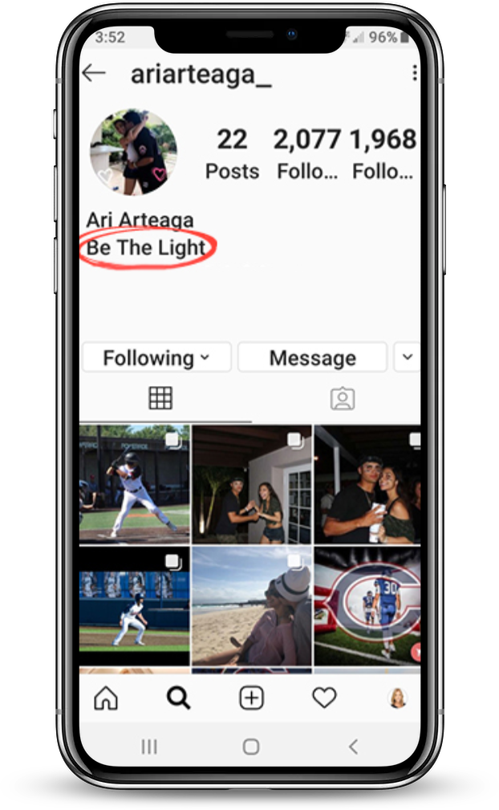
BE THE LIGHT
A few weeks before he passed away, Ari had begun to spread his personal motto,
'BE THE LIGHT,' on his social media and in his everyday life.
Now, the Ari Arteaga Foundation has adopted this motto in his honor as a celebration of his joyful life.
Ari’s light continues to shine through the Foundation’s service to others.
Ari’s motto

Slide 7
BECOME A CLUB MEMBER
Choose the service events you’d like to participate in
Commit to service and spread the word about the club
Sign up on our website
ariarteagafoundation.org/club/
STEP 1
STEP 2
STEP 3

Slide 8
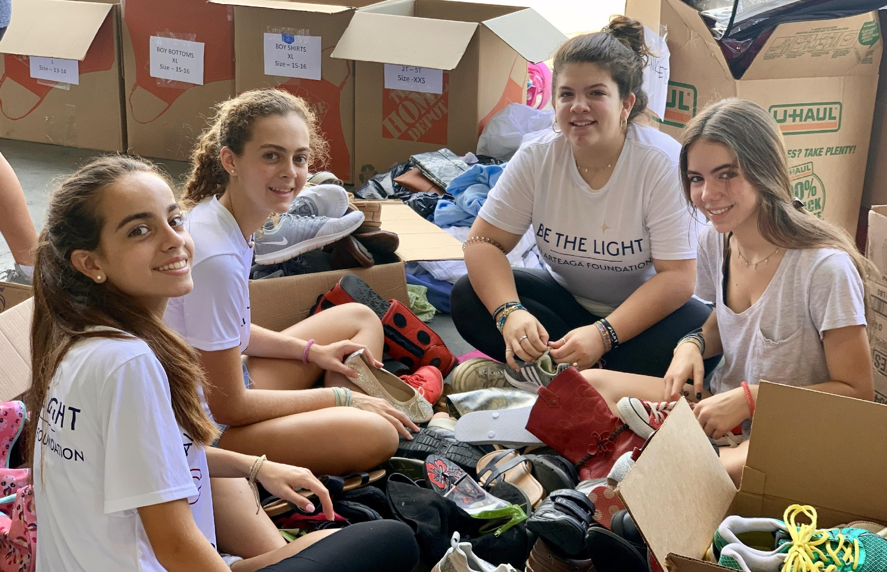
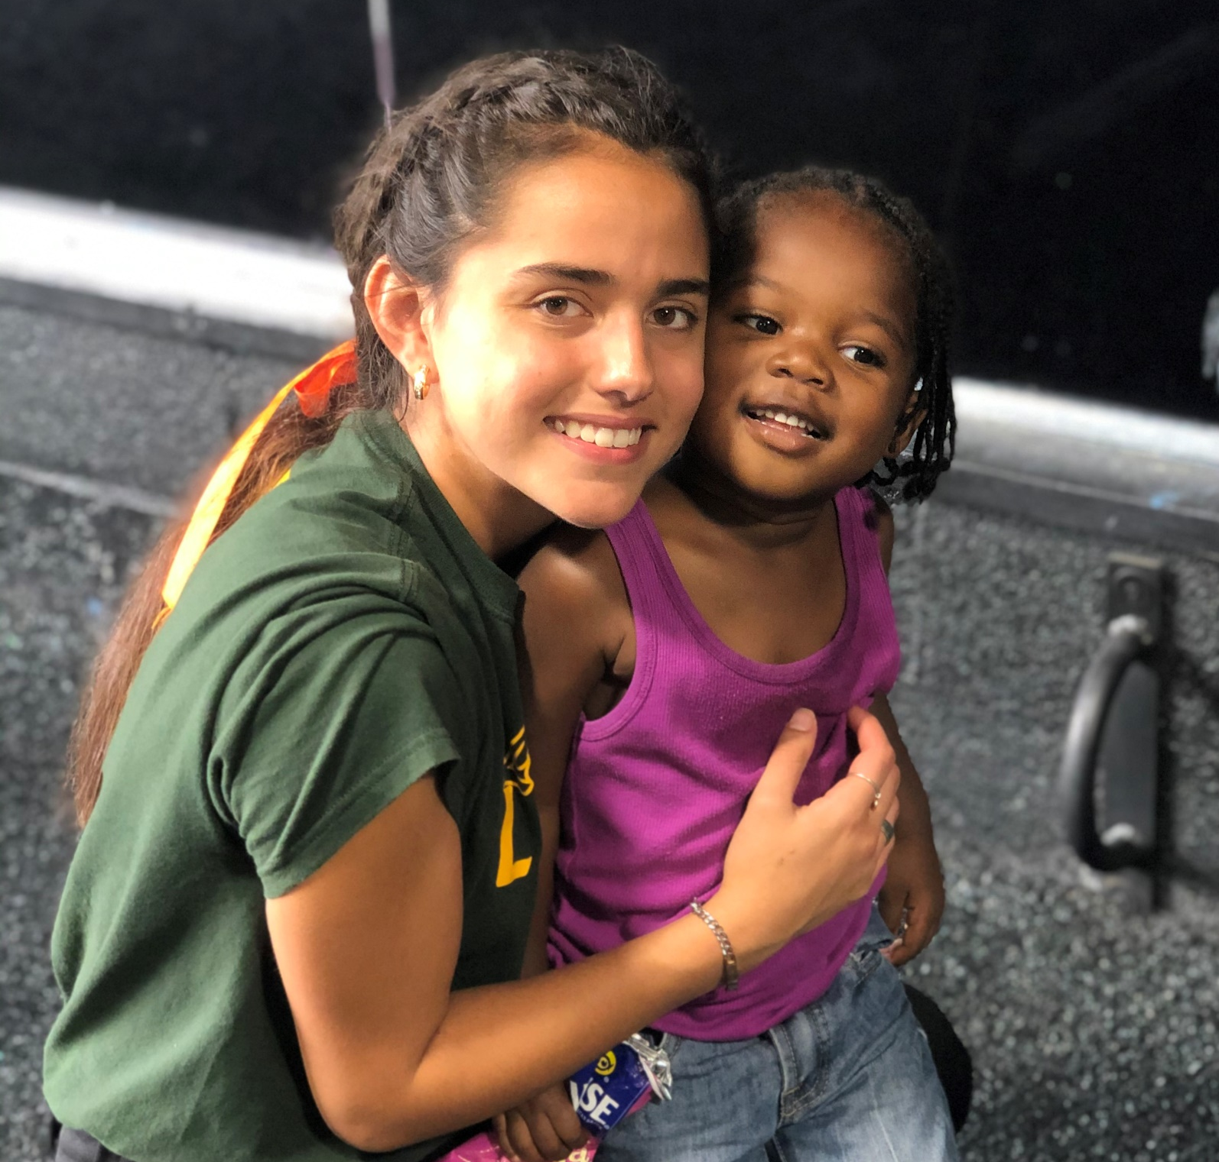
COMMITMENT
1. Choose service activities that interest YOU. Whether it be sports, arts or education, we want you to be energetic and fully engaged when serving your community.
2. Sign up for an event during a time of year that is most feasible for you. For example, if football season is in the fall, look into more spring opportunities.
3. Honor the commitment you choose to make. We predetermine the number of volunteers we need for each event and will be counting on your participation.

Slide 9
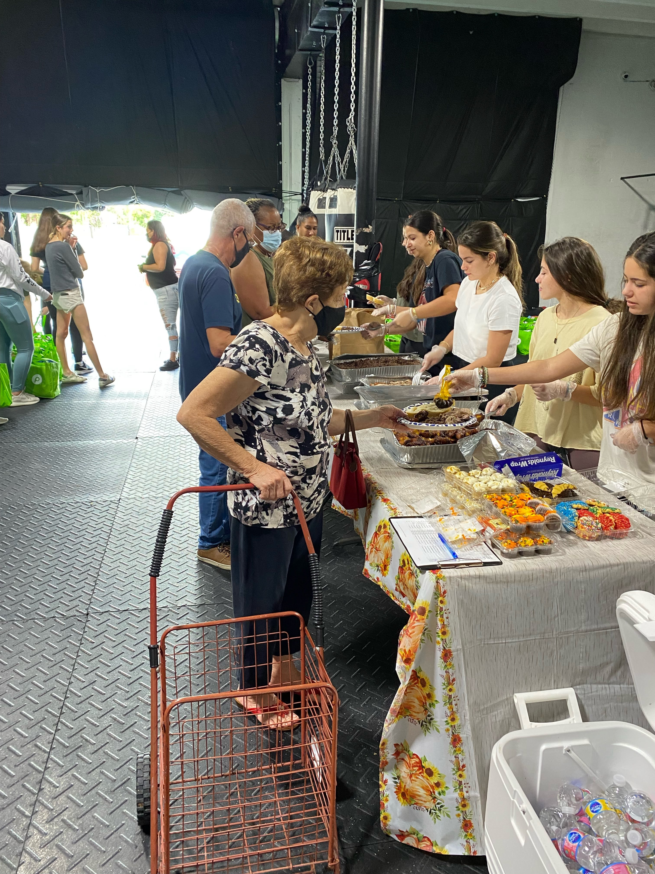
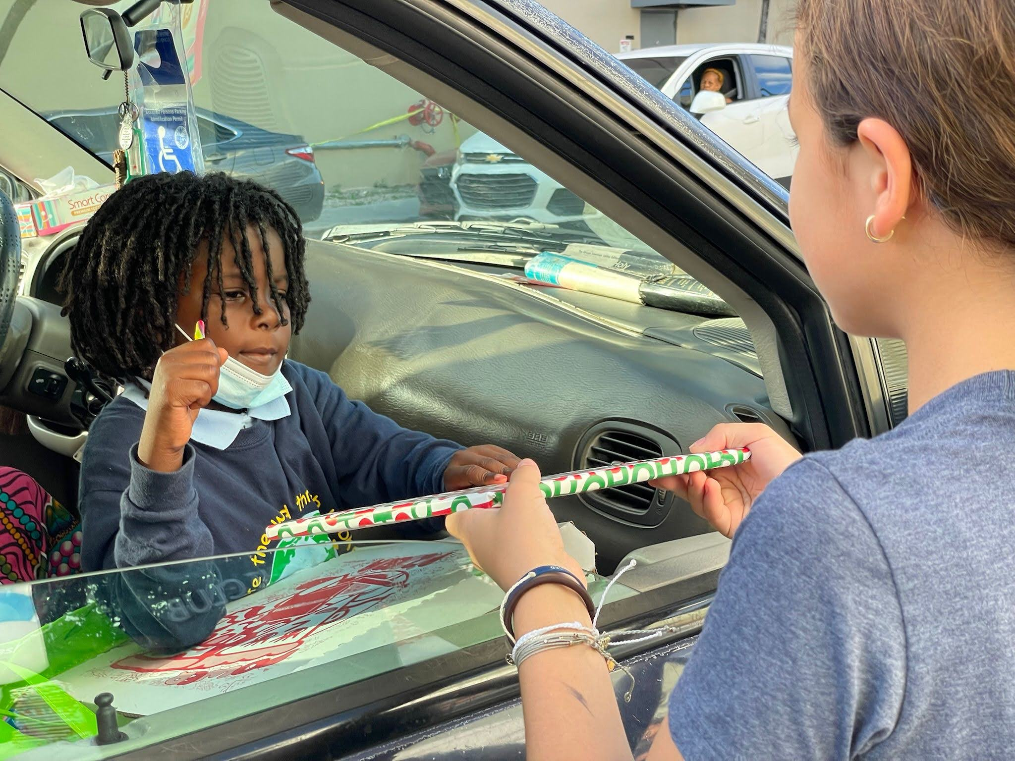

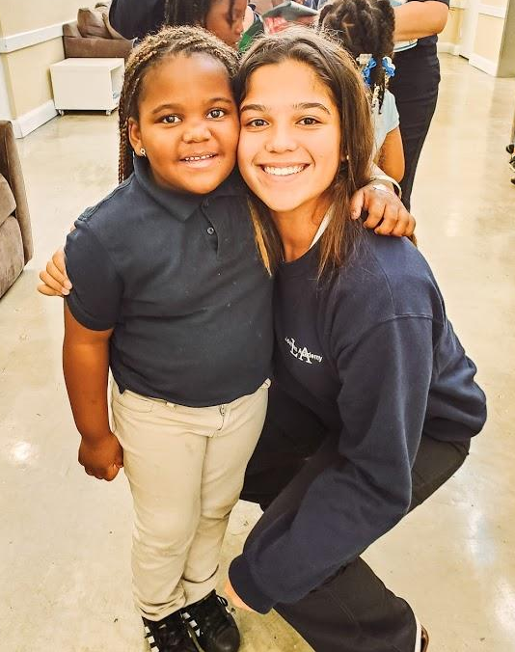
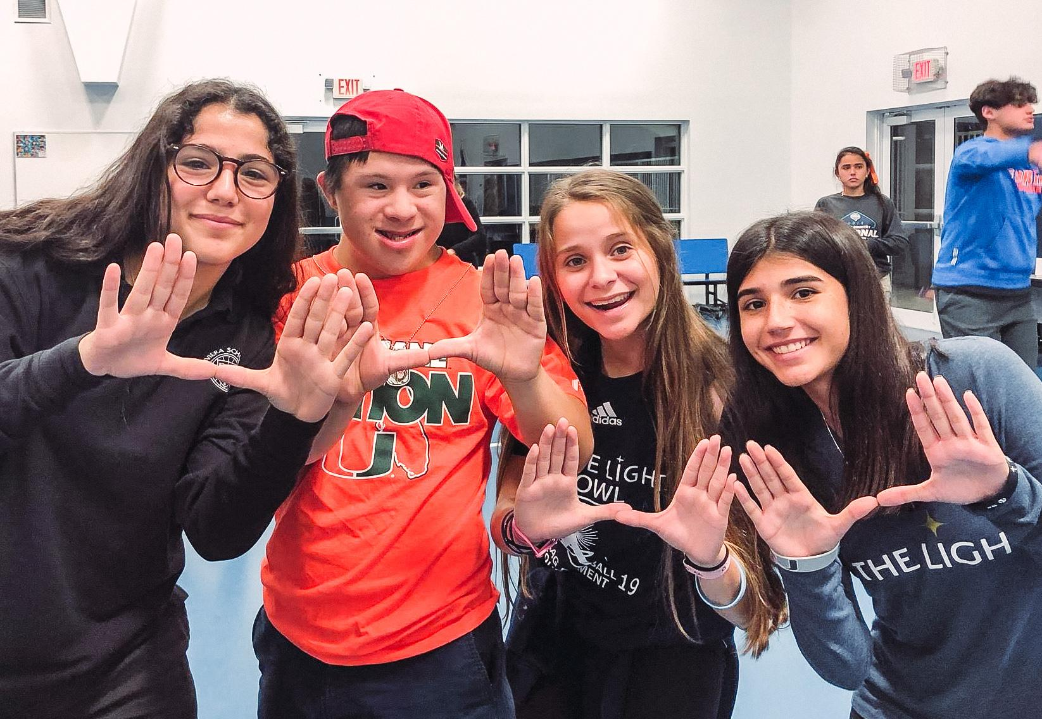
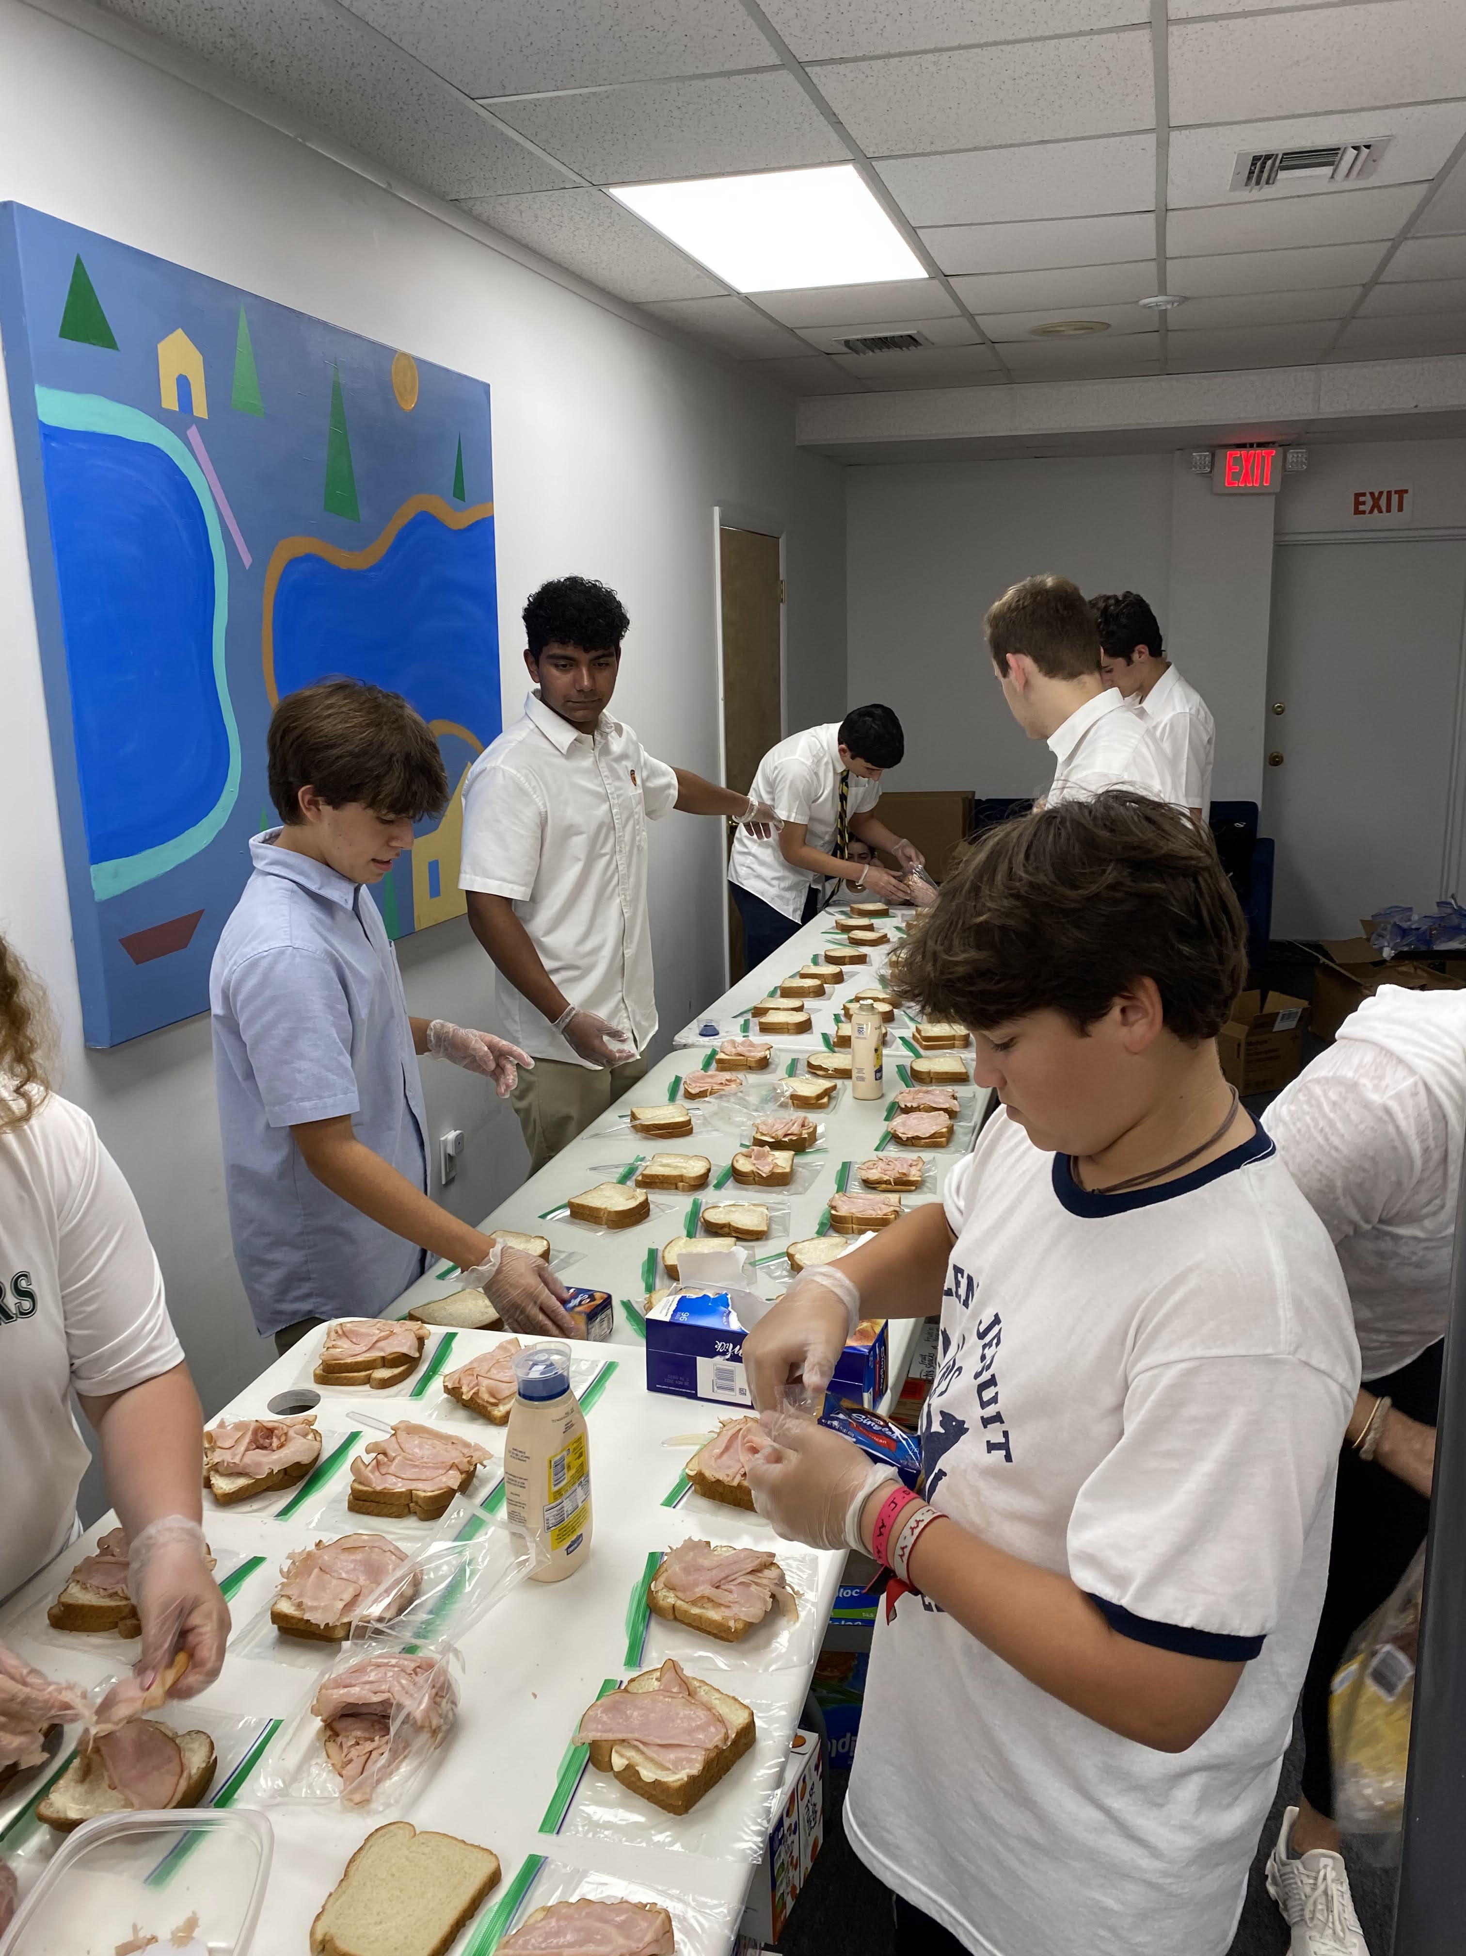
PARTNERS
The Ari Arteaga Foundation has partnered with several local organizations to assist in serving our youth and community.

Slide 10
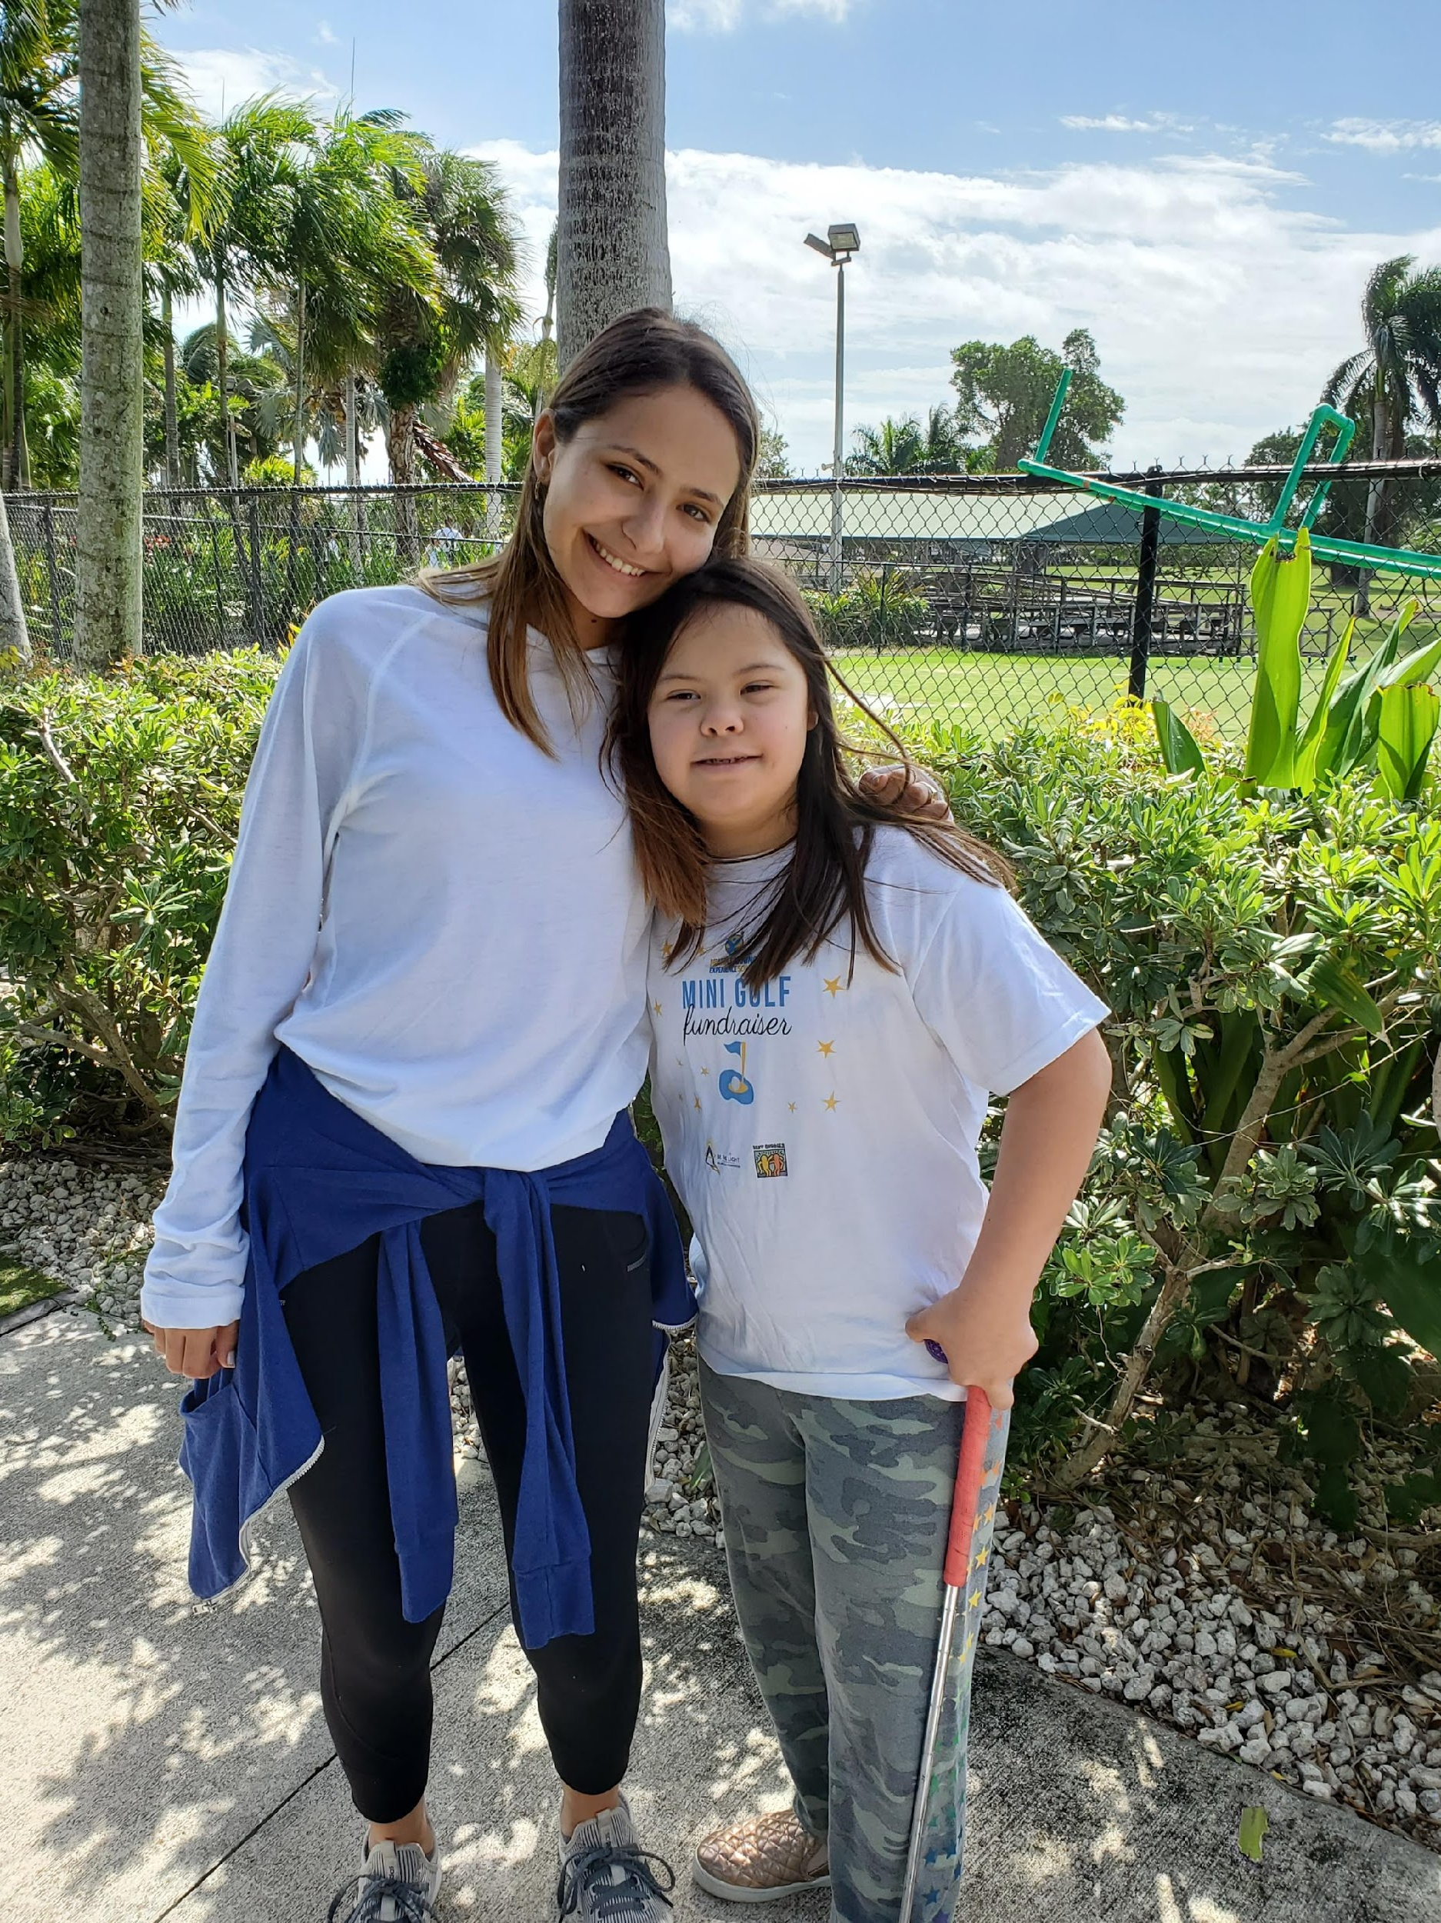

SERVICE
Club members will have a wide variety of direct and indirect service opportunities, which gives them the chance to participate in many different roles and allows them to take more initiative in leading their peers.

Slide 11
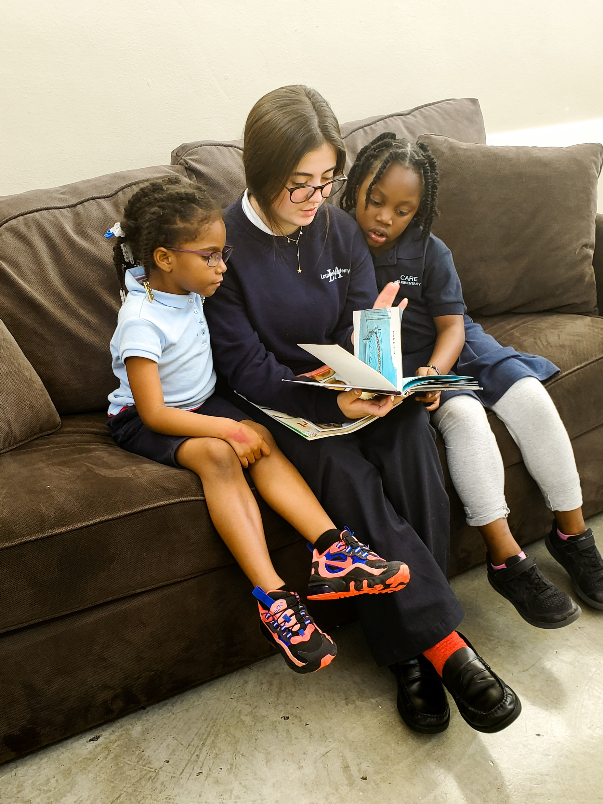
DIRECT SERVICE
Participate in different activities with students from local special needs schools
One-on-one reading time with after school programs
Host and attend birthday parties for the youth in our partner organizations
Participate in extracurricular activities with youth including art, music, and dance
Serve warm meals to community members in need
Thanksgiving distribution of turkeys and non-perishables for families in underserved communities
Direct service opportunities provide hands-on activities that bring club members face-to-face with the people they are serving.
We know how valuable human connection is in learning names, listening to stories and opening our hearts to the light we all share.

Slide 12
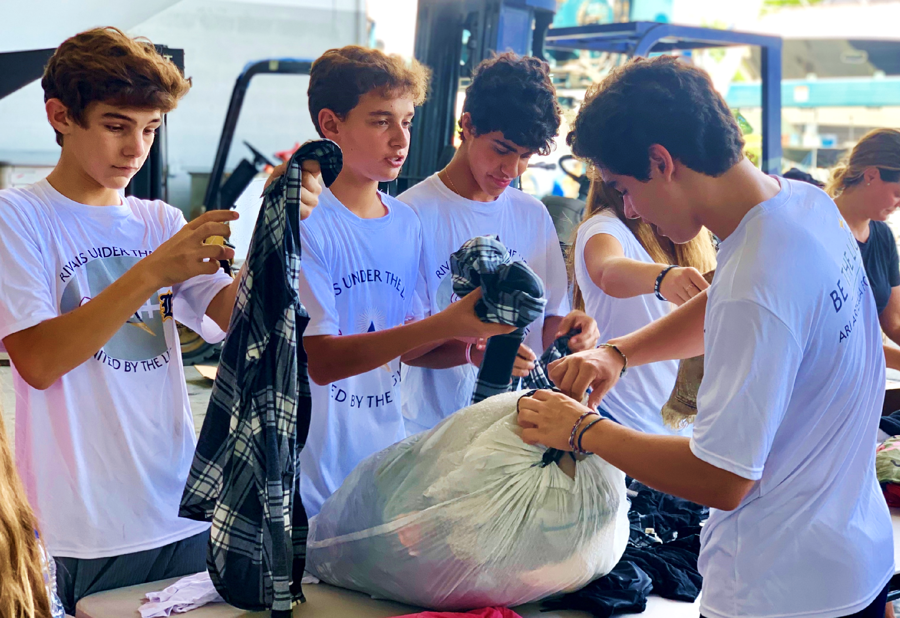
INDIRECT SERVICE
Fundraising
Car wash
Bake Sale
Karaoke
Dress down day
Food Pantry
Collection of non-perishable food
Collection of toiletry items
Collection of other items such as clothes and school supplies
Additional Opportunities
Supporting Ari Arteaga Foundation fundraising events
Preparing for direct service events (e.g. creating decorations, Christmas cards, etc.)
Indirect service opportunities primarily focus on fundraising and collecting/sorting goods to be distributed within the community.
Indirect service opportunities primarily focus on collecting funds and goods to be distributed within the community.

Slide 13
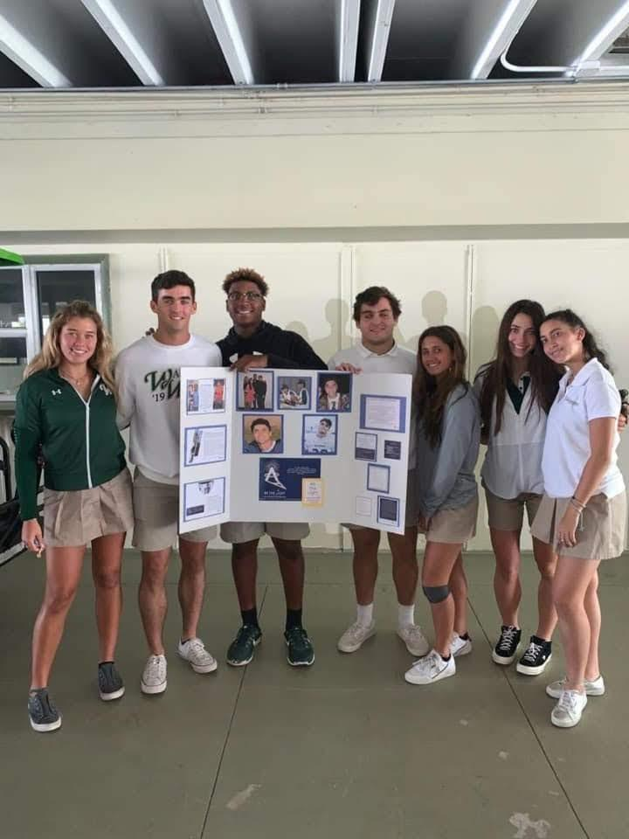
CLUB REQUIREMENTS
Clear communications platform. Once you sign up, we will communicate via:
  E-mail
      Social Media (@bethelightclubmiami, @bethelight30_6)
      Text
We suggest joining efforts with other clubs at your school for at least one service event.
Meetings:
If your school has a club leader or liaison, we suggest meeting once a quarter to stay engaged and up to date with the club’s calendar and upcoming events.
Your involvement is crucial to the success of the
BE THE LIGHT Club. Our Club is inclusive, not exclusive. For this reason, we have specific club and member requirements.

Slide 14
MEMBERSHIP REQUIREMENTS
1
2
3
4
$10 membership fee
Attend BTL Club Service Opps.
Be an advocate for the BTL Club
Stay up to date
Covers the cost of Club member fees for events
-Attend meetings
=Follow us on
social media
-Be on the look out for emails and texts
-Visit our website periodically
Opportunities available on weekdays and weekends
Within school &
outside of school extracurricular activities

Slide 15
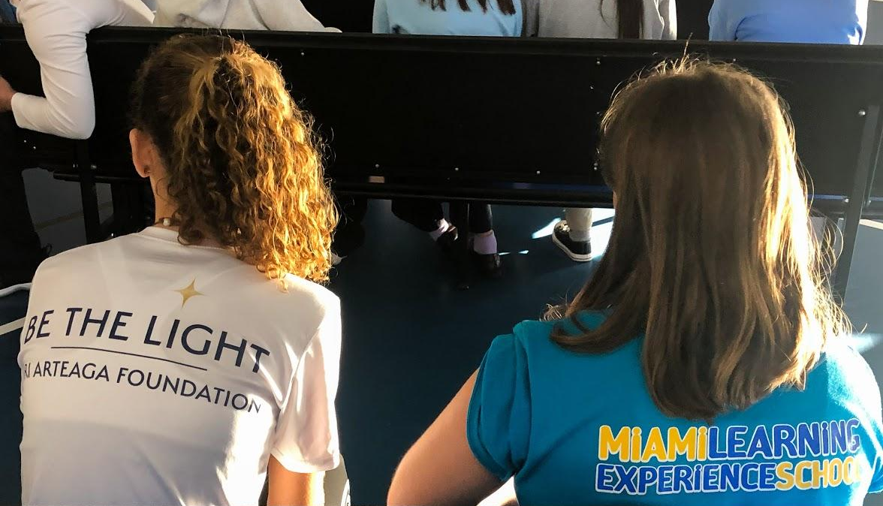
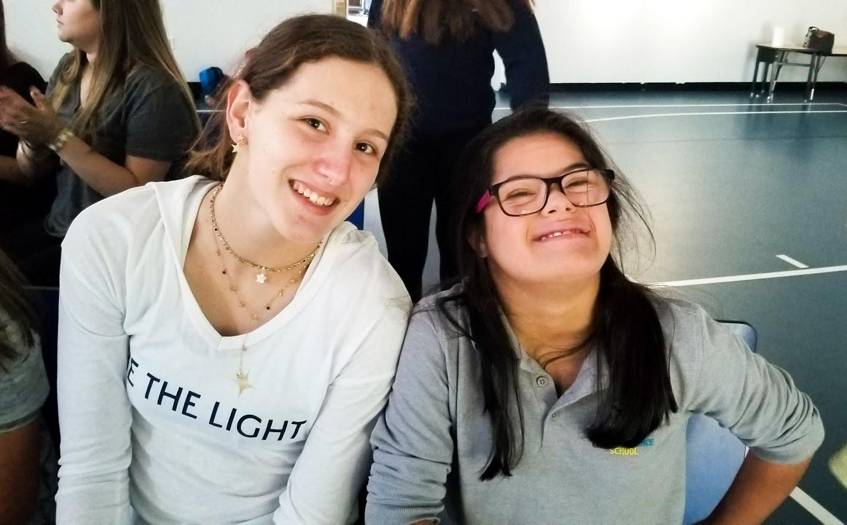
MEMBERSHIP
REQUIREMENTS
Select a service activity that interests you during a time that best fits your schedule.
Sign Club waiver
Minimum participation requirement
10 service hours per school year
  5 indirect service hours
  5 direct service hours
Members cannot miss more than one meeting per school year.

Slide 16
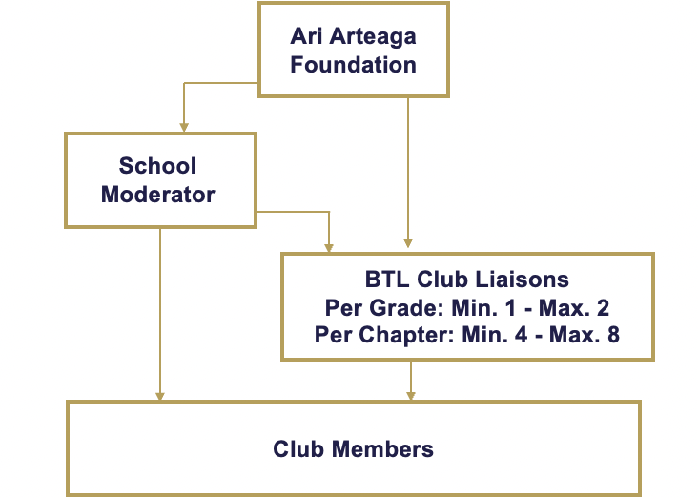
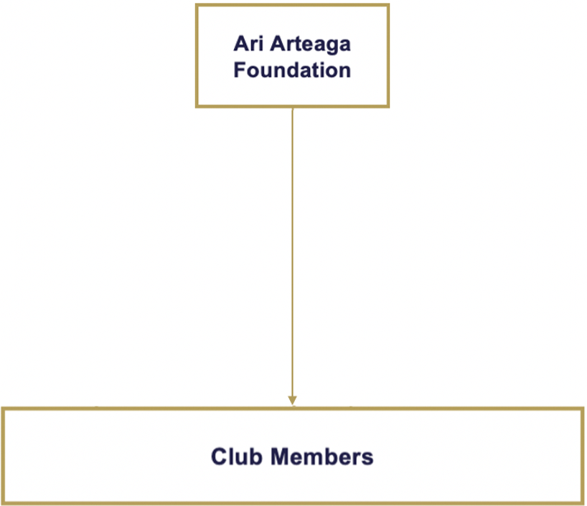

BE THE LIGHT CLUB
COMMUNICATION FLOW CHART
Schools with Established BTL Club Chapters:
Schools with Non-Established BTL Club Chapters:

Slide 17
BTL CLUB REPRESENTATIVE GUIDELINES
The Chapter can have 4 representatives (one per grade) and up to 8 representatives (2 per grade).
Each representative needs to volunteer a minimum of 25 services hours with the BTL CLUB.
The Foundation may appoint representatives, unless the school requires representatives are to be appointed by their administration.
The Foundation may appoint representatives if the BTL CLUB is less than four years old at the school.
All communication between Foundation and representatives regarding their Chapter and the CLUB must be shared with the Moderator, club members and Foundation in a timely manner (within a 24-hour period).
Representatives must schedule four BTL CLUB meetings:
      - September
    - November
    - January
    - March
Representatives cannot miss more than one club meeting in a school year.
Club meeting are to be scheduled during a time of day when all/most club members can attend – right before school/right after school.
Club meetings should not exceed 20 minutes.
Club meeting must include:
  - Meeting Agenda – template provided by Foundation
  - Upcoming volunteer/service opportunities in detail
  - Where to sign up for volunteer opportunity
  - Upcoming fundraiser/s hosted by your chapter

Slide 18
BTL CLUB REPRESENTATIVE GUIDELINES CONT.
In support of our mission, we encourage every chapter to host at least one fundraiser in the school year benefiting the Ari Arteaga Foundation.
  - Fundraiser funds received/collected must be delivered to the Ari Arteaga Foundation with a seven-day period.
Representatives must work together to maintain their BTL CLUB chapter an inclusive club:
  - Be responsible to your role
  - Be respectful to the Moderator and other club members
  - Be inclusive
  - Be responsive to emails, texts, phone calls regarding your participation
  - Have a good and open line of communication. Be approachable and reachable.
  - Share with other non-members about what the club does and encourage them to participate and join.
The Foundation will share their chapter’s club member list with the Moderator and representatives.
Each representative should communicate via text and email with other club members of all upcoming Club events and service opportunities.
INDIRECT SERVICE (FUNDRAISING/DRIVES)
If your club chooses to host and event and/or fundraiser, we will add them to @bethelightclubmiami, @bethelight30_6 and @bethelittlelightclub to support you and help spread community awareness.
Please email SERVICE@ARIARTEAGAFOUNDATION.ORG with your events/fundraisers, or with any questions or suggestions on how to create an event.
Your chapter’s fundraisers and drives must be approved by your school and hosted before, during or after school. Speak to your moderator for assistance and guidance.

Slide 19
CLUB CHAPTERS FUNDRAISER IDEAS
COLLECTION DRIVE IDEAS
*Candle prices shall not vary.
Selling BE THE LIGHT CANDLE Sale (AAF will provide candle sale form with list of candle scents to collect orders). $25 per Candle
Selling I am Blessed/BE THE LIGHT BRACELET Sale
BE THE LIGHT/Ari’s Heart Pop Socket Sale
Hosting a Car wash – combine efforts with another chapter to reach a larger group of supporters. - $5 donation minimum to get car washed.
Bake sale – Bake your own or buy
Dodgeball Tournament at your school
Spike Ball Tournament at your school
Dress down day at school (students pay to dress out of uniform) with BE THE LIGHT GEAR.
Crazy Sock Day or PJ Day
Krispy Kreme Doughnuts Fundraiser
Movie night on your school grounds (in the auditorium, school lawn, or gym)
Karaoke contest during lunch
Family Feud/Jeopardy/Trivia tournament – Pop Culture
Host a dance marathon or themed dance at school
“Drive-In” or movie night on your school yard - movie event
Talent show
Non-perishable Food/water
Toiletry – Travel Size
Diapers/baby supplies
Turkey drive and non-perishables (with Ari Arteaga Foundation)
Christmas toy drive/gift card
Children’s books – new or lightly used
School supplies
Sports Gear

Slide 20
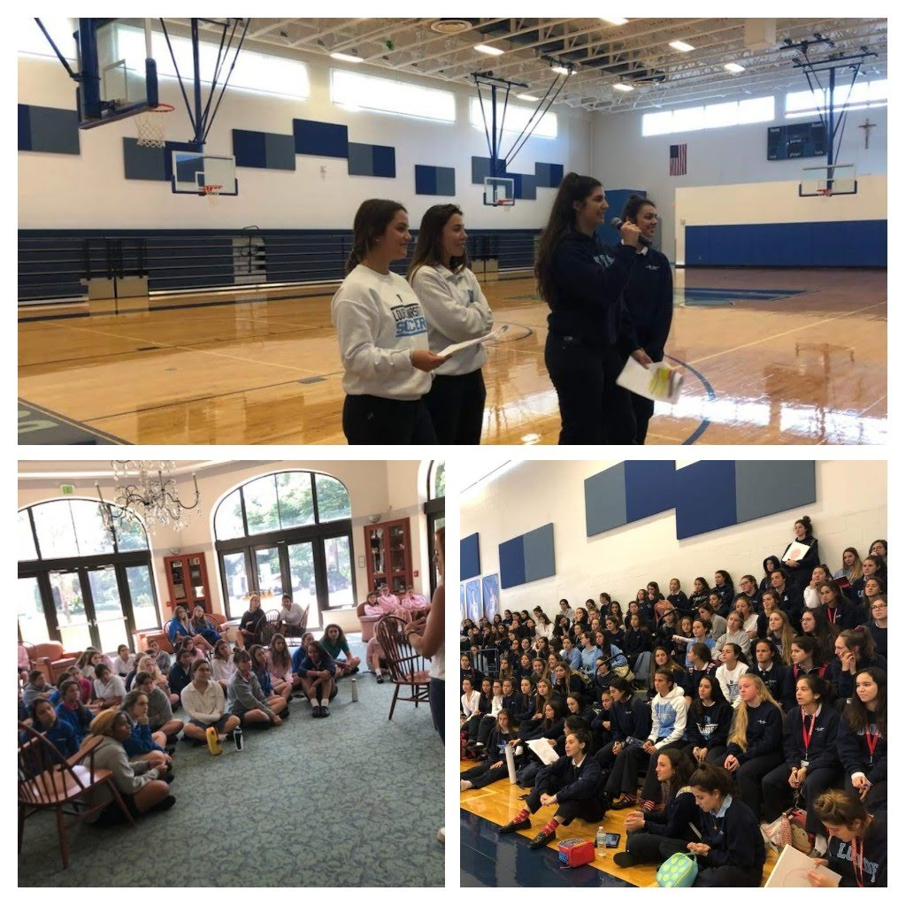
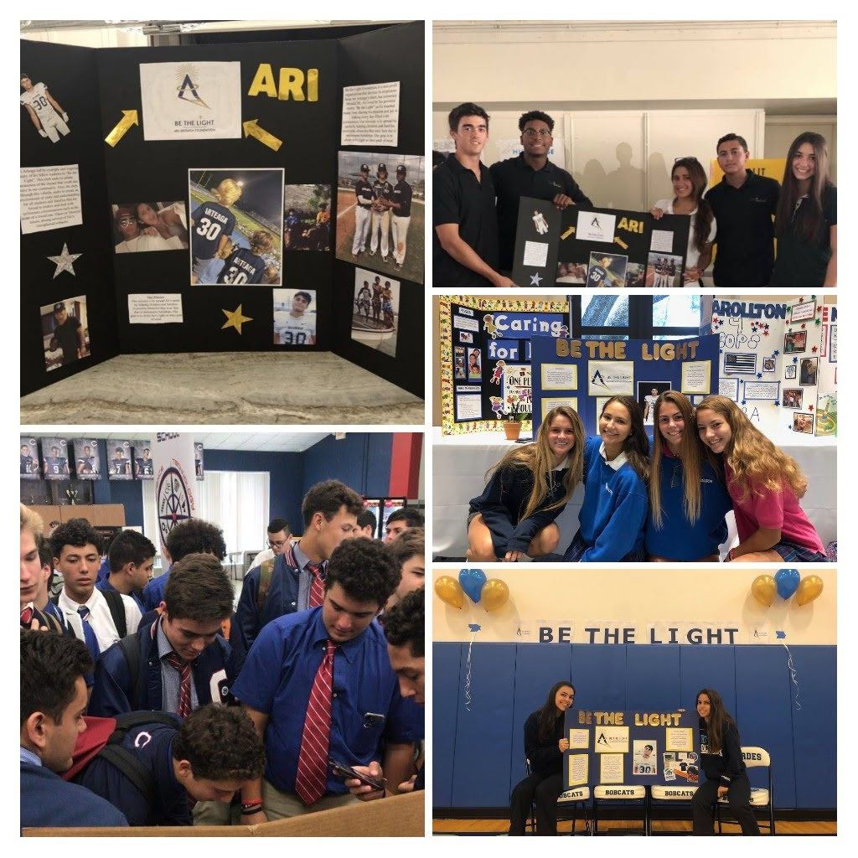
CLUBS ON CAMPUS
Club Meetings
Club Fair Day at School

Slide 21
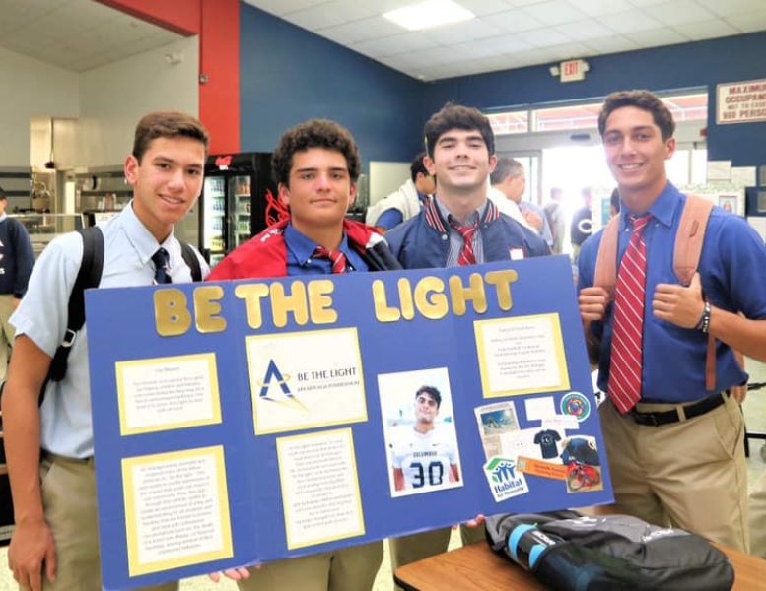
CURRENT CHAPTERS
The BE THE LIGHT Club has established its presence throughout local private high schools to continue serving the community through our youth programs.
Schools
Christopher Columbus High School
Our Lady of Lourdes Academy
Carrollton School of the Sacred Heart
Westminster Christian School
Belen Jesuit Preparatory
Immaculata La Salle High School
Florida Christian School
Est.
2018
2018
2018
2018
2019
2019
2019

Slide 22
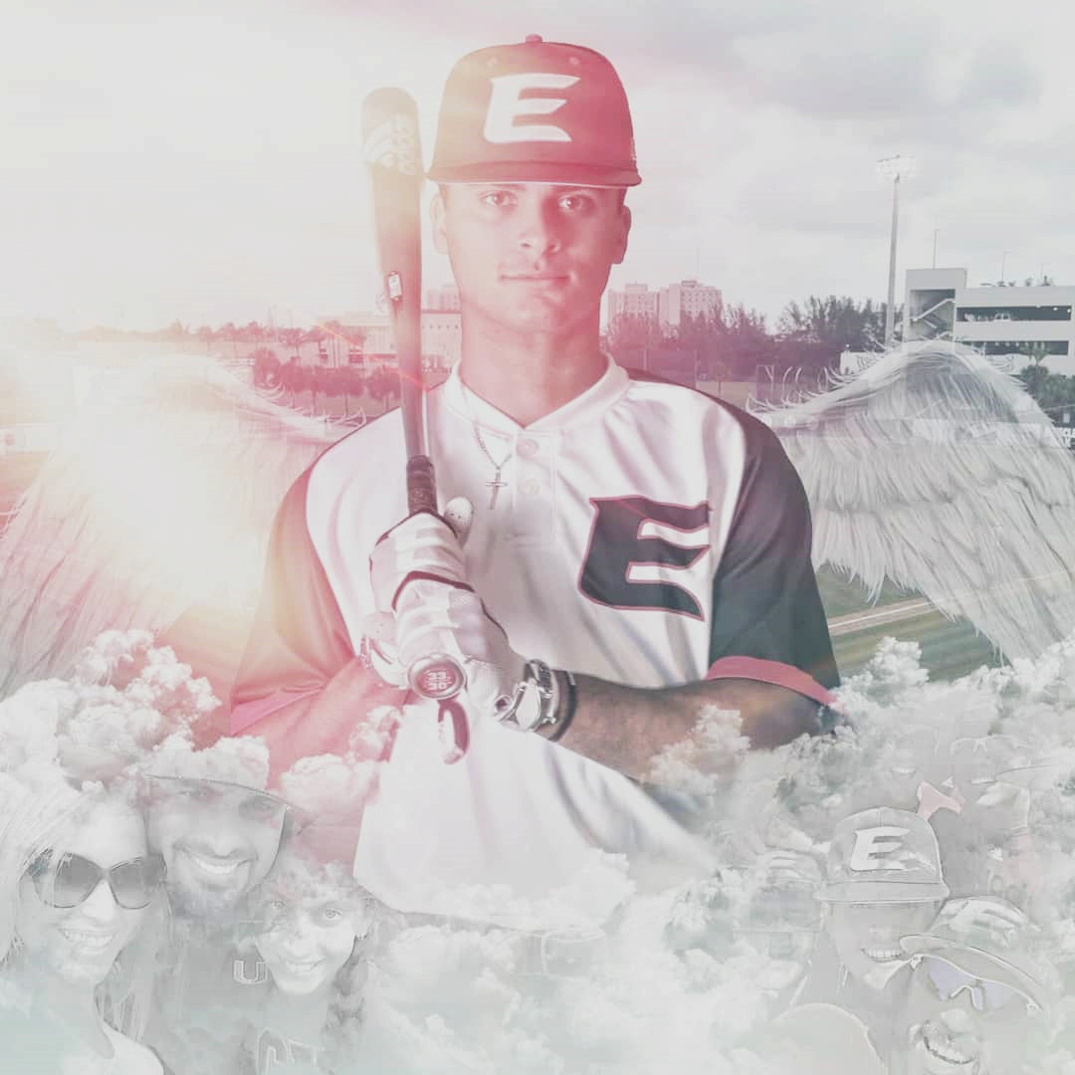
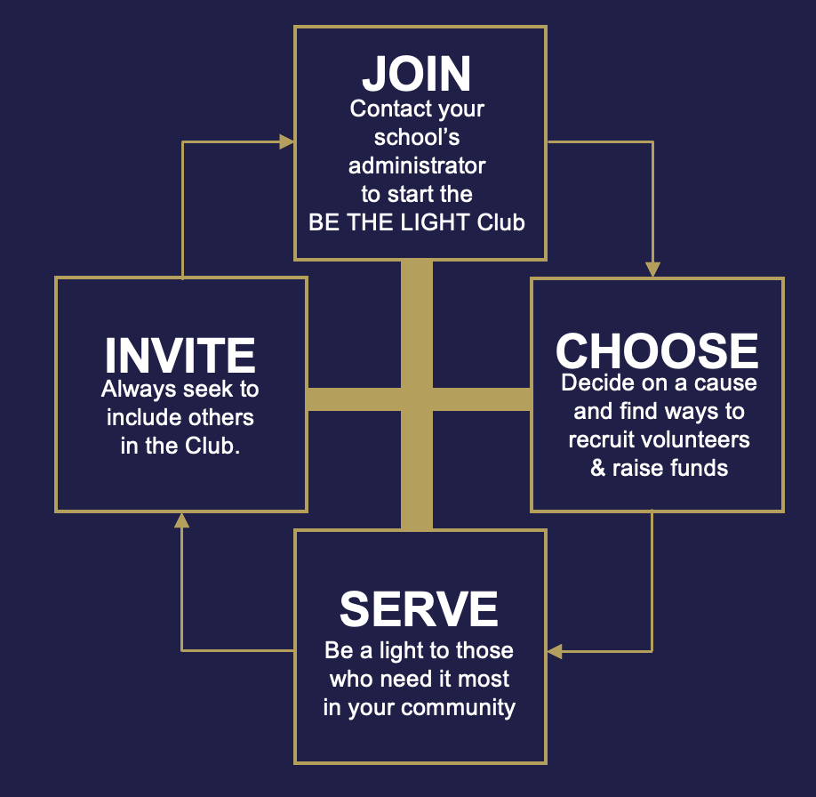
THE
ARI ARTEAGA FOUNDATION
Serves as a constant testimony that although life on this earth is temporary, the impact and expanse of our love is eternal.
Join us in continuing Ari’s legacy by being a light for others through service.
For more information:
www.ariarteagafoundation.org
Email: service@ariarteagafoundation.org

Slide 23
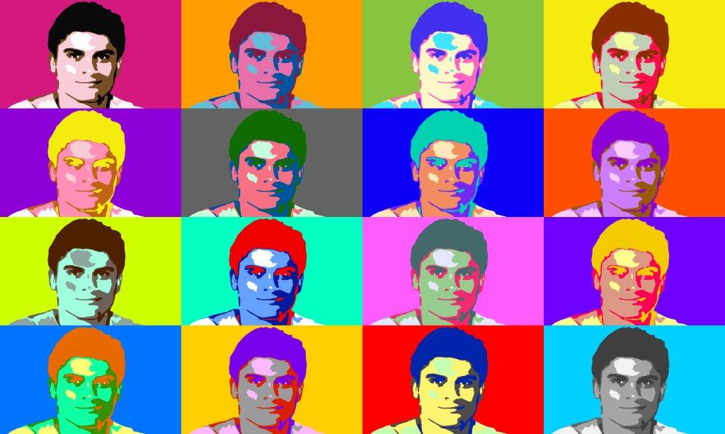

THANK YOU!
KEEP UP WITH US ON SOCIAL MEDIA:
@bethelightclubmiami
@bethelight30_6
@bethelightshop_online

